Slide 1
SPECIAL USE PERMIT CASE NUMBER WSUP20-0014 Red Peak West Cell Tower
Washoe County Board of Adjustment
December 3, 2020

Slide 2
Request
Removal of an existing 15-foot-tall cellular communication tower and the construction and operation of a new 40-foot-tall cellular communication tower.

Slide 3
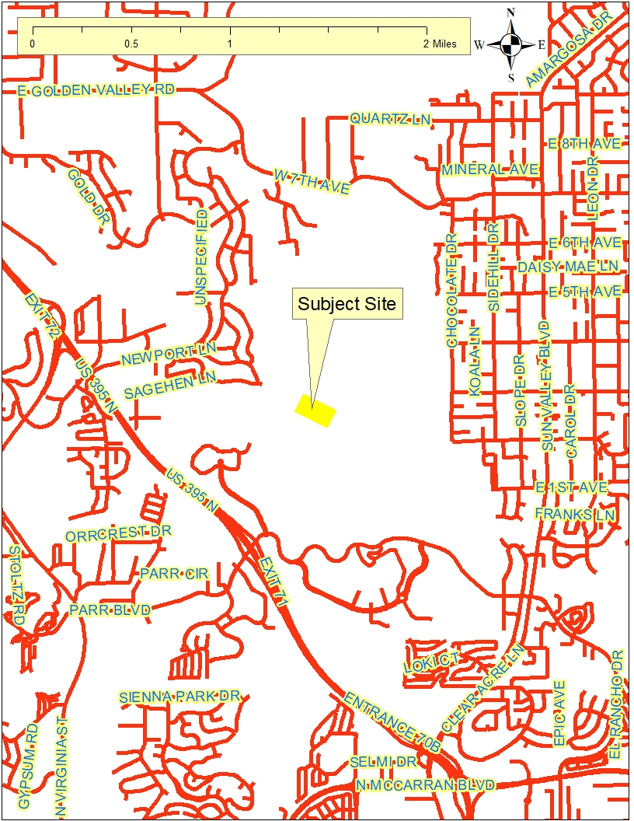
Vicinity Map

Slide 4
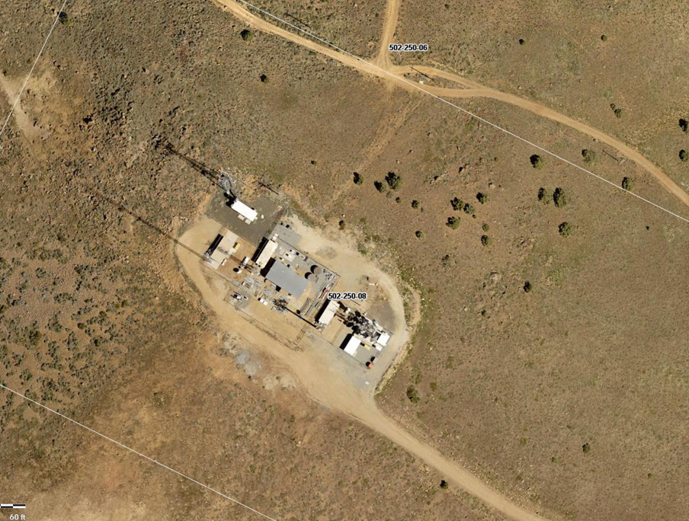
Over Head Photo

Slide 5
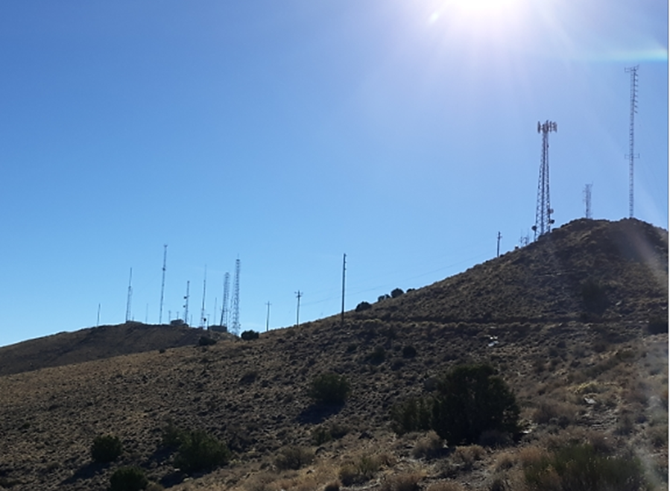
Site Photo

Slide 6
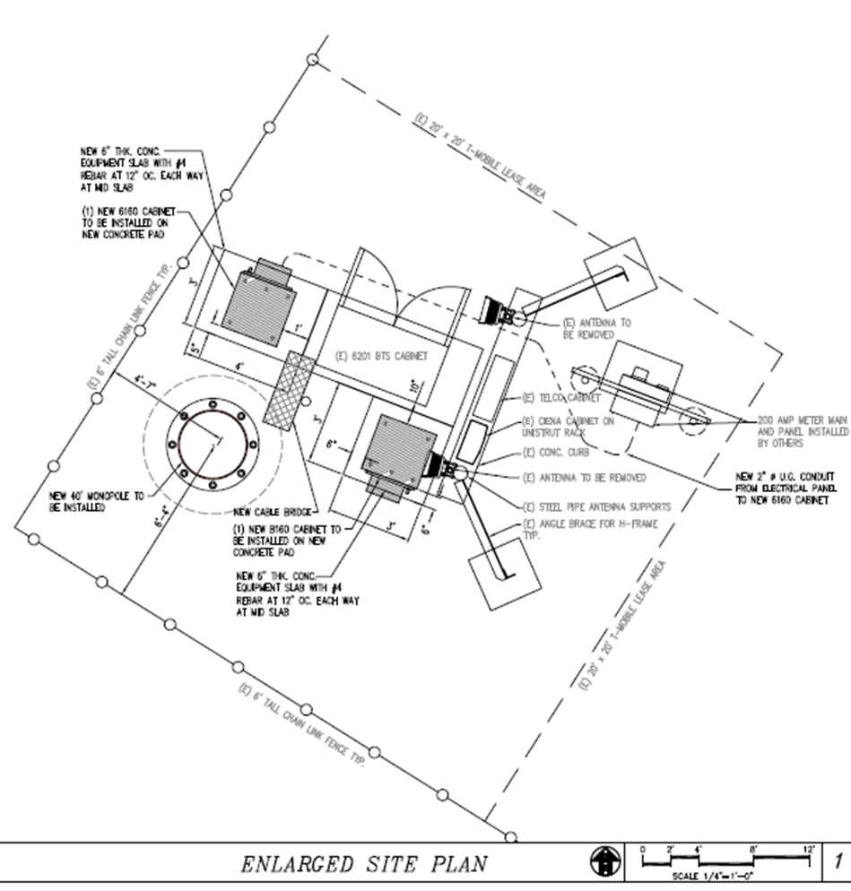
Site Plan

Slide 7
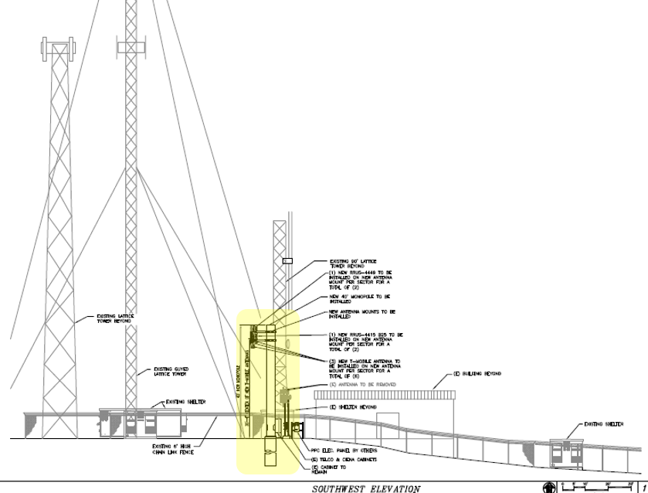
Site Plan Elevation

Slide 8
Overview
Remove 15-foot tower
Construct 40-foot tower
Among many others
No discernable impacts
Complies with all relevant Code standards

Slide 9
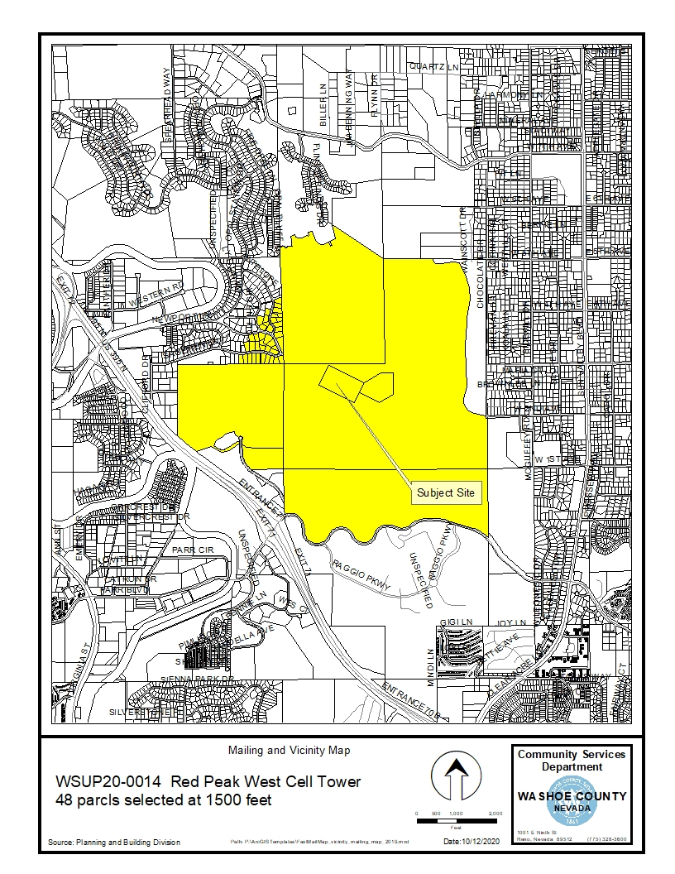
Public Notice & CAB
Notice sent to 48 affected property owners
Sun Valley CAB reviewed the application on October 19, 2020:
Recommended approval.

Slide 10
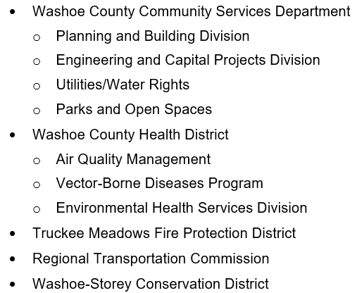
Reviewing Agencies
No recommendations for denial were received.

Slide 11
Special Use Permit Findings
Staff comments on findings are on pages 12-13 of the staff report.
1. Consistency. That the proposed use is consistent with the action programs, policies, standards and maps of the Master Plan and the North Valleys Area Plan;
2. Improvements. That adequate utilities, roadway improvements, sanitation, water supply, drainage, and other necessary facilities have been provided, the proposed improvements are properly related to existing and proposed roadways, and an adequate public facilities determination has been made in accordance with Division Seven of the Development Code;
3. Site Suitability. That the site is physically suitable a for a telecommunications facility (monopole) for the intensity of such a development;
4. Issuance Not Detrimental. That issuance of the permit will not be significantly detrimental to the public health, safety or welfare; injurious to the property or improvements of adjacent properties; or detrimental to the character of the surrounding area.
5. Effect on a Military Installation. Issuance of the permit will not have a detrimental effect on the location, purpose or mission of the military installation.
Findings required by Section 110.324.75, for a telecommunications facility:
6. That the communications facility meets all the standards of Sections 110.324.40 through 110.324.60 as determined by the Director of Community Development and/or his/her authorized representative;
7. That public input was considered during the public hearing review process; and
8. That the monopole or lattice tower will not unduly impact the adjacent neighborhoods or the vistas and ridgelines of the County.

Slide 12
Recommendation
After a thorough analysis and review, Special Use Permit Case Number WSUP20-0002 is being recommended for approval with conditions.

Slide 13
Possible Motion
I move that, after giving reasoned consideration to the information contained in the staff report and information received during the public hearing, the Washoe County Board of Adjustment approve with conditions Special Use Permit Case Number WSUP20-0014 for 51 Wireless, LLC. having made all findings in accordance with Washoe County Code Section 110.810.30 and Section 110.324.75, subject to the conditions contained in Exhibit A to the Staff Report.

